Slide 1

Teachify – Learning Platform For Kids
Presented by:-
Devansh Kopra - 21107013
Ayush Mistry - 21107029
Mayank Kumar – 21107016
Sahil Mujumdar - 21107050
Project Guide -
Mr. Vaibhav Yavalkar

Slide 2
Introduction :
Teachify is an innovative and engaging learning app designed specifically for children. The app offers a range of features that help kids learn in a fun and interactive way
The aim of this app is to make education more easy and interactive for every children
Problem identified was that all students follow traditional way of studying
This application provides proper and interactive way of learning from home

Slide 3
Objectives :
To provide easy and interactive platform for learning for everyone
To Improve efficiency and effectiveness of acquiring Knowledge
To improve user accessibility and time flexibility to engage learners in the learning process
To enhance Quality learning

Slide 4
Features :
Simple and Intuitive Learning :Teachify has bright colors and engaging visuals that capture children’s attention
Dictionary : It enables user to get every word it searches
Talking Bot : User can interact with bot and learn multiple languages more efficiently
Wikipedia : It provides user to search everything and get result in multiple languages
Planned Courses : The courses are planned according to children’s age group and their learning ability

Slide 5
Scope :
Thinking Skills: Teachify develops and improves children’s Thinking ability more efficiently
Communication Skills: With the help of talking bot children can improve their communication skills and learn multiple languages at very young age.
Learning Skills: It motivates children to learn new things

Slide 6
Project Outcome :
Teachify helps user to experience new way of studying rather than traditional way
Simple and interactive content for children
With this user will save time and cost as they can learn many new things from their home
Teachify provides kids with a fun and interactive way to learn new concepts and skills , which can help them in school and academics

Slide 7
Technology Stack :
FRONT END :-
Pycharm 2022.3.2
BACK END :-
MySQL 8.0

Slide 8
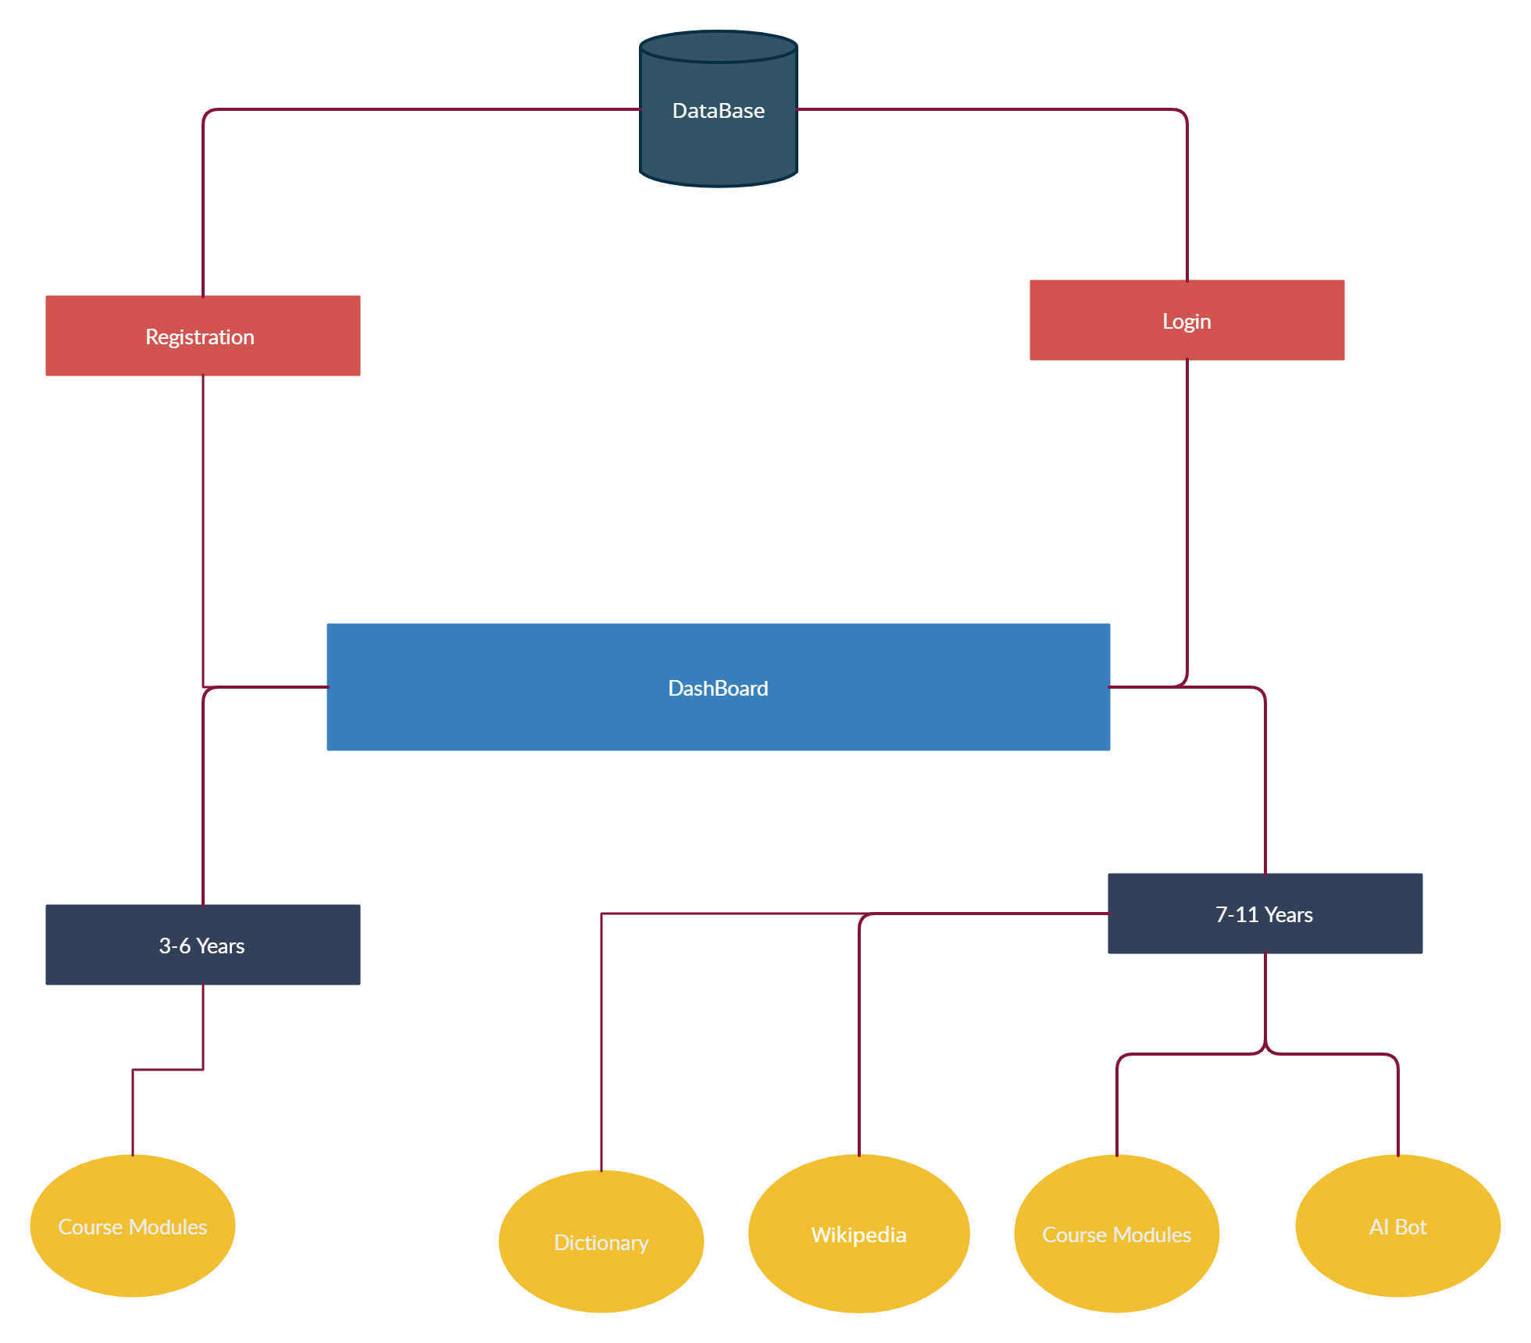
Block Diagram

Slide 9
Thank You...!!

